Slide 1
Design Improvement for Coaxial Cable Connector using
Six Sigma
Saravana Palanisamy
University of Nebraska Lincoln

Slide 2
Company Overview
SSFPO Vs DFSS
DFSS Roadmaps
Problem Approach
DEFINE Phase
MEASURE Phase
ANALYSIS Phase
CDOV – Product Design Process
Cost Benefit Analysis
Conclusion

Slide 3
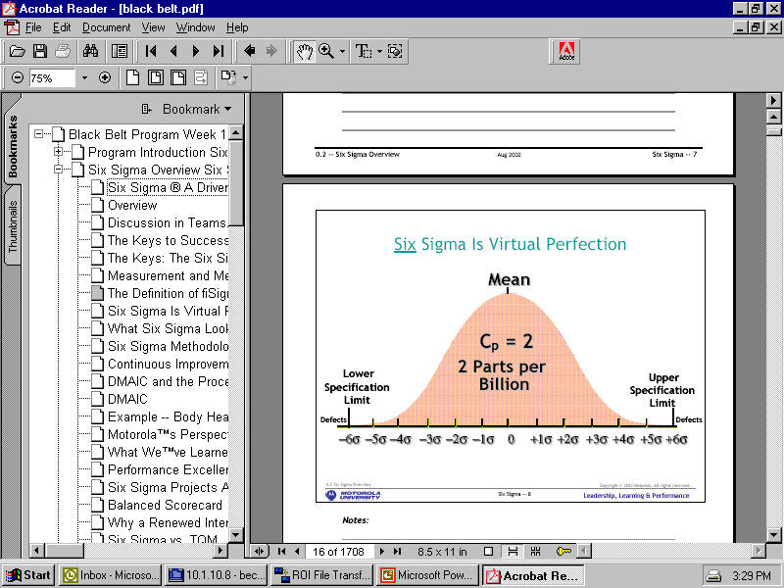

Slide 4
SSFPO Vs DFSS
Six Sigma for Production Operations uses DMAIC and has little to do with Product Development
Design for Six Sigma based on I²DOV or CDOV and is to do with
  Technology Development
  Product Commercialization

Slide 5
Project Road Map
Define
Measure
Analyze
Conceptualize
Design
Optimize
Verification of Capability

Slide 6
DMA-CDOV
The foundation of the process
1.0
Define
Opportunities
2.0
Define
Performance
3.0
Analyze
Opportunities
4.0
Conceptualize
5.0
Design
What is important?
How are we doing?
What is wrong?
How can we do it better?
Can we give a form to it?
6.0
Optimize
7.0
Verify
Does it need tuning?
Is this we wanted?

Slide 7
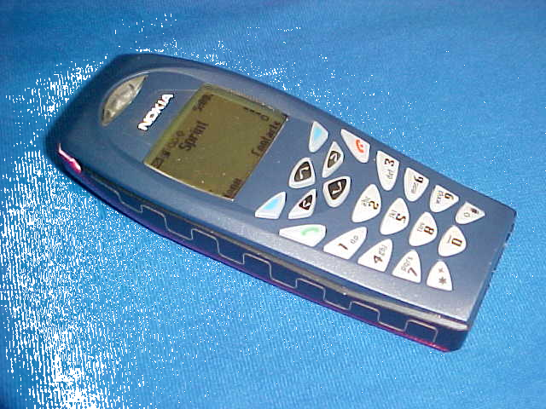

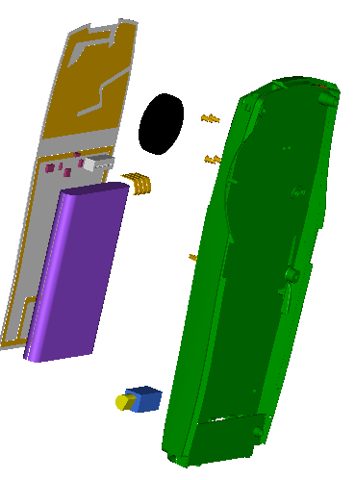
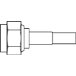
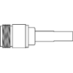
Identification of Improvement Areas
CELLULAR ANTENNA
SPEAKER
CAMERA
(not shown)
GPS ANTENNA
Antenna
Connectors
MISC. CIRCUITRY
MIDDLE DECK
HOUSING
N-Male
N-Female
FM ANTENNA
BATTERY
VIBRATOR RINGER

Slide 8
Team Charter
Team Selection & Responsibilities
Team Member Name | Responsibility Areas (e.g. submittimg deliverables & reports to PMO, action plan updating, inter-project team communications, liaison to PMO for Communications/Change Management activities, etc.)
Executive Sponsor:
Team Lead: | Jon Sullivan
Project Manager: | Saravana Palanisamy
Member: | Giri Suppiah
Member: | Robert Slawinski
Member: | Roger Kavanaugh

Slide 9
Project Time-Line
Activity Form Teams Finalize Charter Gather data-existing Coax connector Preliminary Concept design Select Design Prototype Development Mechanical testing Tool Development Full Testing | Time
 | July Aug Sep Oct Nov Dec

Slide 10
DEFINE Phase
The high sub assembly time and the cost of the coaxial cable connector faced by the internal/external customers at Centurion needs a fix.
Coaxial cable connector forms 30% of the equipment cost
Assembly cost for the connector makes 50% of the connector cost
DEFINE
MEASURE
ANALYZE
CONCEPT
DESIGN
OPTIMIZE
VERIFY

Slide 11
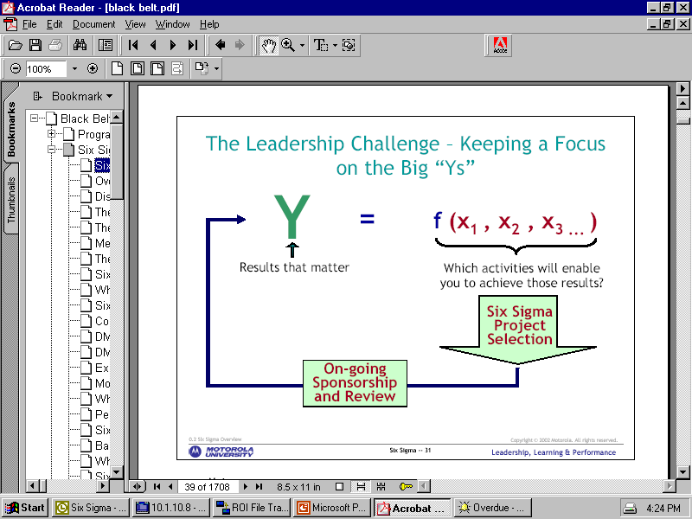
Factors(x): KPIV
Design of Connector
Type of Crimping
Wire preparation
Primary metrics (Y): KPOV:
Assembly Time
Secondary Metrics(y): Cost of Connector, new business opportunity
DEFINE
MEASURE
ANALYZE
CONCEPT
DESIGN
OPTIMIZE
VERIFY

Slide 12
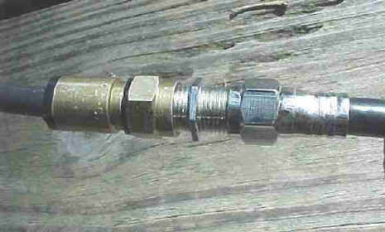
Process Map
Sub Assembly
RF Connector – 8 Parts
Assembly:
RF Connector – Metal Crimping
RF Connector
N-Male
Mechanical Crimping
Mechanical Crimping
Assemble male components onto the wire
Assemble female components onto the wire
Prepare the wire
Prepare the wire
N-Female
DEFINE
MEASURE
ANALYZE
CONCEPT
DESIGN
OPTIMIZE
VERIFY
THE INFORMATION CONTAINED IN THIS DOCUMENT IS OF A PROPRIETARY NATURE AND IS INTENDED TO BE KEPT CONFIDENTIAL BETWEEN THE OWNER AND THE INTENDED AUDIENCE.
IT MAY NOT BE REPRODUCED OR USED WITHOUT EXPRESS WRITTEN PERMISSION OF CENTURION WIRELESS TECHNOLOGIES, INC., LINCOLN, NEBRASKA, USA.

Slide 13
ANALYZE Phase
The existing connector in the market involves 8 different components to be assembled using a metal crimping machine and it involves time and labor
DEFINE
MEASURE
ANALYZE
CONCEPT
DESIGN
OPTIMIZE
VERIFY

Slide 14
Process Map
Final assy
Time: 30 secs
N-Male
N-Female
Mechanical Crimping
Mechanical Crimping
Time: 30 secs *2
Assemble male components onto the wire
Assemble female components onto the wire
Time: 30 secs *2
Prepare the wire
Prepare the wire
Time :30 secs *2
DEFINE
MEASURE
ANALYZE
CONCEPT
DESIGN
OPTIMIZE
VERIFY

Slide 15
Fish Bone
DESIGN
Wire Prep
Assy time
More parts
Connector sub Assy
Metal crimping
DEFINE
MEASURE
ANALYZE
CONCEPT
DESIGN
OPTIMIZE
VERIFY

Slide 16
Concept Development
VOC- Critical Customer Requirements
Key Customer Issue(s)
Voice of the Customer |  | Critical Customer Requirement
What does the customer want from us? | We need to identify the issue(s) that prevent us from satisfying our customers. | We should summarize key issues and translate them into specific and measurable requirements
Less Labor Intensive | Wire prep., Connector sub Assy | Less parts, Easy Assembly
Quick Assembly | Wire prep., Need for external M/c | Less parts, Press fit (avoid ext M/c)
Cheap | Gold plating, More parts | Cheap material, Less parts
Low Assembly cost | Metal crimping M/c, Labor intensive assy | Auto Insulation removal, Few parts, Easy Assy procedures
DEFINE
MEASURE
ANALYZE
CONCEPT
DESIGN
OPTIMIZE
VERIFY

Slide 17
DESIGN
Design Intent:
  Connector with fewer parts, ease of assembly like press fit, made of cheaper material, with auto insulation removal system and with easy assembling procedures.
Design Concept:
  Insulation Displacement Connectors
DEFINE
MEASURE
ANALYZE
CONCEPT
DESIGN
OPTIMIZE
VERIFY

Slide 18
DESIGN Concept
IDC’s
  Developed in 1980’s
  Replaced the entire electrical connector
  Assembly efficiency increased by 80%
DEFINE
MEASURE
ANALYZE
CONCEPT
DESIGN
OPTIMIZE
VERIFY

Slide 19
Pugh Analysis
Choosing Among Design Alternatives
Criteria | A | B | C
Ease of Grounding | - | + | +
Ease of Assembly | + | + | +
Manufacturability | - | + | +
Aesthetics | 0 | 0 | 0
Cost Effective | - | - | +
Sum of + | 1 | 3 | 4
Sum of 0 | 1 | 1 | 1
Sum of - | 3 | 1 | 0
Rank | 3 | 2 | 1
Continue | no | yes | yes
DEFINE
MEASURE
ANALYZE
CONCEPT
DESIGN
OPTIMIZE
VERIFY

Slide 20
Manufacturing Concept
Prototyping
Tolerance Stacking
Assess Process Capability
DFMA
DEFINE
MEASURE
ANALYZE
CONCEPT
DESIGN
OPTIMIZE
VERIFY

Slide 21
OPTIMIZE
Design FMEA
Item Function | Potential Failure Mode | Potential Effects of Failure | SEV | Occur | Detect | Potential Cause of Failure | Current Design Control | Recommended action
Primary Contact | Improper Insulation Displacement | Loss of connection | 10 | 4 | 1 | Improper Assy; Contact not placed properly or not sharp | X,Y,Z directional resistance with positive stops | Tighter tolerance on Knife edges
Secondary contact | Drop off | Loss of Connection | 10 | 4 | 1 | Loss of Spring action; Improper assy | Material with high stiffness; positive lock | Positive Y direction arrest
Primary contact | Not touching the circuit board | Loss of connection | 10 | 2 | 1 | Loss of spring action; Improper assy | Tighter tolerances; Material with high stiffness | Tighter tolernace on primary contact
Wire | Drop off | Loss of Connection | 10 | 2 | 1 | Improper assembly | Positive push from top part | Postive arrest of wire from slipping
DEFINE
MEASURE
ANALYZE
CONCEPT
DESIGN
OPTIMIZE
VERIFY

Slide 22
Validate
Prototypes tested for mechanical and functional capabilities
Tolerances verified
SPC charts are planned for production
DEFINE
MEASURE
ANALYZE
CONCEPT
DESIGN
OPTIMIZE
VERIFY

Slide 23
Cost Benefit Analysis
Cost saving : $3/connector (for internal customer)
Average saving : $300,000 per year
(Avg. consumption of 100,000 components/yr)
Current market potential for the coaxial cable connectors is 4.5 million parts per annum
A baseline of 45million dollar market (average cost of 10$ per connector). This can be taken up by Centurion or the design could be sold to capable manufacturers at a reasonable cost (patent applied)

Slide 24
Questions???

